Slide 1





Faculty of Engineering and Technology (Excusive for women)
Department of Computer Science and Engineering .
CRIME PREDICTION AND ANALYSIS
under the guidence of
DR.Manikamma malipatil
Presented by:
PATLOLLA SUSHMA(SW22CSE055)
AISHWARYA GT(SW22CSE005)
CHAITRA(SW22CSE028)
CHANNAMMA(SW22CSE030)

Slide 2

Introduction
Crime Prediction and Analysis System is a web-based tool built with Python, Flask, and machine learning. It helps predict future crimes and analyze past crime data based on location, and type of crime. The system provides interactive maps and visuals to make crime trends easy to understand. This tool can support police, city planners, and the public in improving safety and planning. This helps people understand and forecast crime patterns. By analyzing past crime data (like place and type of crime), the system predicts where and when crimes might happen in the future.

Slide 3
objectives of project
Automate Crime Prediction & Trend Analysis:
Develop a system that uses past crime data (location ,type) to predict future crime occurrences.
Enable State-wise & Crime-type Visualizations:
Show crime patterns using detailed information and interactive maps for easy understanding.
Assist Law Enforcement & Policymakers:
Provide insights to help identify high-risk areas and support better resource planning and crime prevention.
Improve Public Awareness & Transparency:
Allow citizens to explore crime trends in their area, increasing safety awareness and trust.
Store & Display Historical and Predicted Data:
Maintain a record of past and predicted crimes, shown through tables and visual dashboard.

Slide 4
Features of Project
Crime Prediction
Predict future crimes based on historical data, location and crime type using machine learning.
Data Visualization
Display crime trends using maps and dashboards for better understanding.
Interactive Crime Map
Show crime locations on an interactive map with filters for state, crime type.
Historical Data Analysis
Analyze past crime records to observe patterns and hotspots.
Future Crime Forecasting
Generate future crime predictions and visualize them alongside historical data.
Dataset Upload & Management
Upload, manage, and view datasets for crime records in the admin panel.

Slide 5
Methodology
Data Collection and Preprocessing
Collected crime data from public datasets (like CSV files).
Converted text-based columns (e.g., time, location) into numeric format for processing.
Model Building and Training
Built a simple machine learning model using basic Python libraries.
Trained the model using features like crime type, location, and time of occurrence.
Backend Development
Developed backend using Flask to handle crime rate predictions.
Created API routes to connect data processing, model, and frontend.
Frontend and Visualization
Designed web pages using HTML, CSS, and JavaScript for user interaction.
Integrated maps using Plotly and Leaflet.js to show crime trends.
Deployment and Testing
Configured it to open automatically in the web browser when run locally.
Tested the system using both real and sample data for proper output and visuals.

Slide 6
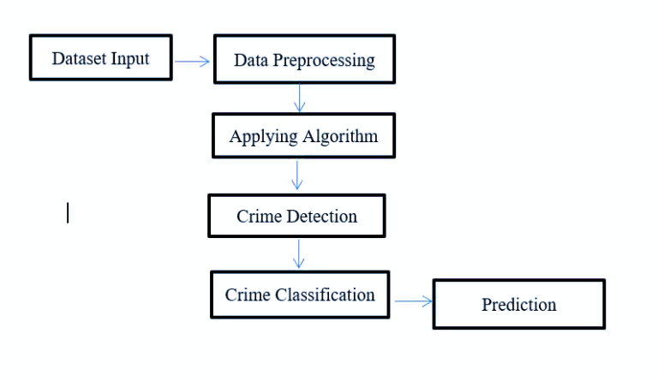
Flow diagram

Slide 7
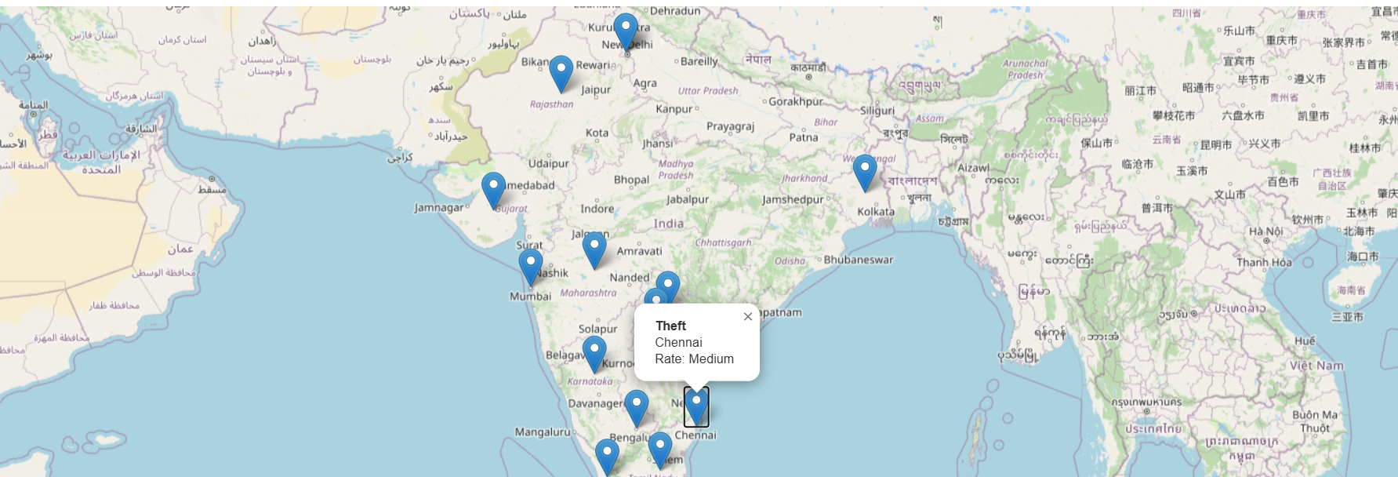
Result and discussion
Fig 1:Information about location based crime visualization

Slide 8
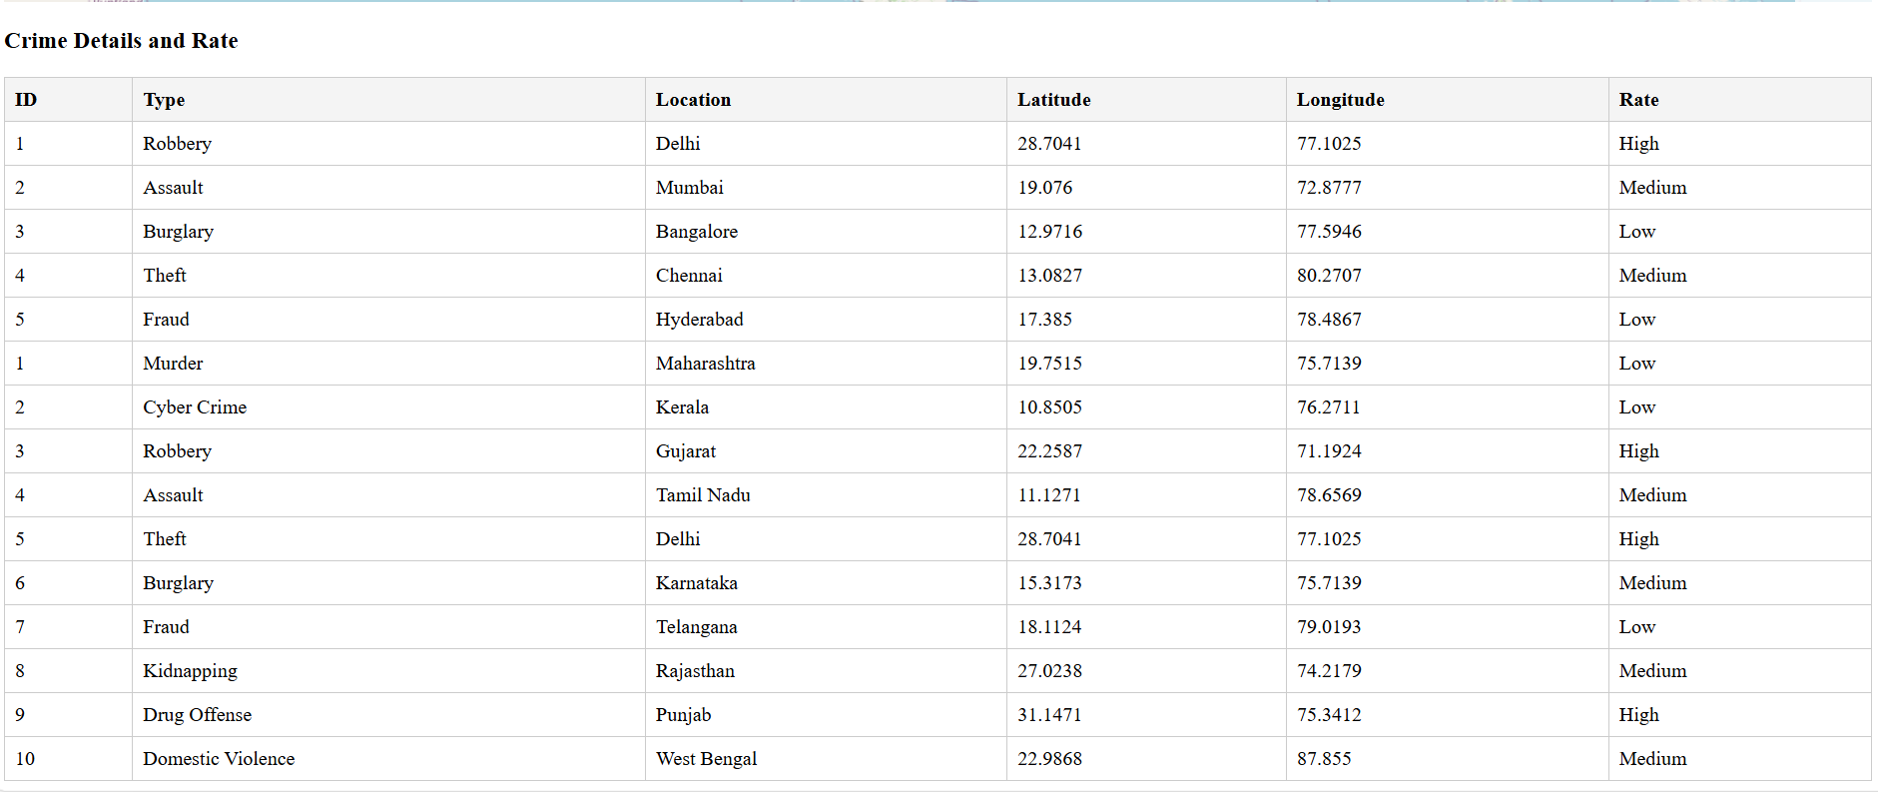
Fig 2: information about crime types and rate.

Slide 9
Conclusion
The Crime Prediction and Analysis System effectively combines machine learning and web technologies to help users analyze and predict crimes. With its interactive map and clear crime details, it allows users to explore regional crime patterns and make informed decisions. This system can assist law enforcement and the public in identifying high-risk areas. Future improvements like real-time data and mobile app integration can make it even more impactful for real-world crime prevention.

Slide 10

THANK YOU

